Slide 1
Python Session 6.2 – Modules

Slide 2
Modules
When a Python program starts it only has access to a basic functions and classes.
(“int”, “dict”, “len”, “sum”, “range”, ...)
“Modules” contain additional functionality.
Use “import” to tell Python to load a module.
>>> import math
>>> import nltk
Use classes & functions defined in another file
A Python module is a file with the same name (plus the .py extension)
import somefile
from somefile import *
from somefile import className

Slide 3
import …
import somefile
Everything in somefile.py gets imported.
To refer to something in the file, append the text “somefile.” to the front of its name:
somefile.className.method(“abc”)
somefile.myFunction(34)

Slide 4
from … import *
from somefile import *
Everything in somefile.py gets imported
To refer to anything in the module, just use its name. Everything in the module is now in the current namespace.
Take care! Using this import command can easily overwrite the definition of an existing function or variable!
className.method(“abc”)
myFunction(34)

Slide 5
from … import …
from somefile import className
Only the item className in somefile.py gets imported.
After importing className, you can just use it without a module prefix. It’s brought into the current namespace.
Take care! Overwrites the definition of this name if already defined in the current namespace!
className.method(“abc”) ⬅ imported
myFunction(34) ⬅ Not imported

Slide 6
Directories for module files
Where does Python look for module files?
The list of directories where Python will look for the files to be imported is sys.path
This is just a variable named ‘path’ stored inside the ‘sys’ module
>>> import sys
>>> sys.path
['', '/Library/Frameworks/Python.framework/Versions/2.5/lib/python2.5/site-packages/setuptools-0.6c5-py2.5.egg’, …]
To add a directory of your own to this list, append it to this list
sys.path.append(‘/my/new/path’)

Slide 7
import the math module
>>> import math
>>> math.pi
3.1415926535897931
>>> math.cos(0)
1.0
>>> math.cos(math.pi)
-1.0
>>> dir(math)
['__doc__', '__file__', '__name__', '__package__', 'acos', 'acosh',
'asin', 'asinh', 'atan', 'atan2', 'atanh', 'ceil', 'copysign', 'cos',
'cosh', 'degrees', 'e', 'exp', 'fabs', 'factorial', 'floor', 'fmod',
'frexp', 'fsum', 'hypot', 'isinf', 'isnan', 'ldexp', 'log', 'log10',
'log1p', 'modf', 'pi', 'pow', 'radians', 'sin', 'sinh', 'sqrt', 'tan',
'tanh', 'trunc']
>>> help(math)
>>> help(math.cos)

Slide 8
Os module
This module provides a portable way of using operating system dependent functionality.
os.chdir(path)
os.fchdir(fd)
os.getcwd()
os.makedirs(path[, mode])
os.mkdir(path[, mode])
os.removedirs(path)
os.rename(src, dst)

Slide 9
Os Accesing file
os.access(path, mode)
try:
fp = open("myfile")
except IOError as e:
if e.errno == errno.EACCES:
return "some default data"
# Not a permission error.
raise
else:
with fp:
return fp.read()
if os.access("myfile", os.R_OK):
with open("myfile") as fp:
return fp.read()
return "some default data“
os.F_OK - Value to pass as the mode parameter of access() to test the existence of path.
os.R_OK - Value to include in the mode parameter of access() to test the readability of path.
os.W_OK - Value to include in the mode parameter of access() to test the writability of path.
os.X_OK - Value to include in the mode parameter of access() to determine if path can be executed.

Slide 10
Sys module
System-specific parameters and functions
sys.argv
sys.exit([arg])
sys.getdefaultencoding()
sys.getrefcount(object)
sys.modules
sys.path

Slide 11
Datetime module
The datetime module supplies classes for manipulating dates and times in both simple and complex ways. While date and time arithmetic is supported, the focus of the implementation is on efficient attribute extraction for output formatting and manipulation. For related functionality, see also the time and calendar modules.

Slide 12
Availaible types
class datetime.date - An idealized naive date, assuming the current Gregorian calendar always was, and always will be, in effect. Attributes: year, month, and day.
class datetime.time - An idealized time, independent of any particular day, assuming that every day has exactly 24*60*60 seconds (there is no notion of “leap seconds” here). Attributes: hour, minute, second, microsecond, and tzinfo.
class datetime.datetime - A combination of a date and a time. Attributes: year, month, day, hour, minute, second, microsecond, and tzinfo.
class datetime.timedelta - A duration expressing the difference between two date, time, or datetime instances to microsecond resolution.
class datetime.tzinfo - An abstract base class for time zone information objects. These are used by the datetime and time classes to provide a customizable notion of time adjustment (for example, to account for time zone and/or daylight saving time)
Subclass relationships:
object
timedelta
tzinfo
time
date
datetime

Slide 13
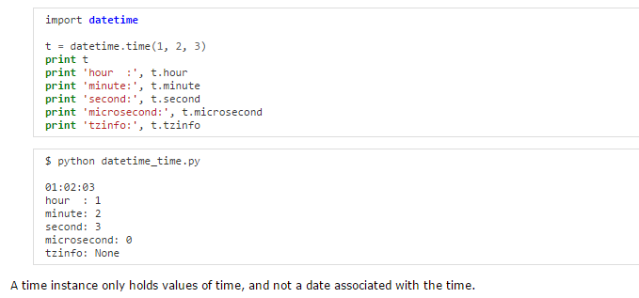
datetime – Time
Time values are represented with the time class. Times have attributes for hour, minute, second, and microsecond. They can also include time zone information. The arguments to initialize a time instance are optional, but the default of 0 is unlikely to be what you want.

Slide 14
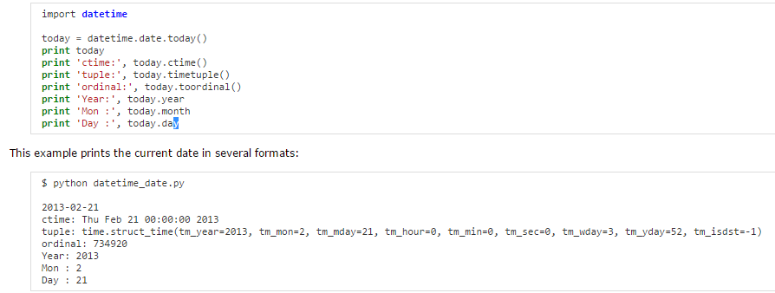
datetime – Date
Calendar date values are represented with the date class. Instances have attributes for year, month, and day. It is easy to create a date representing today’s date using the today() class method.

Slide 15
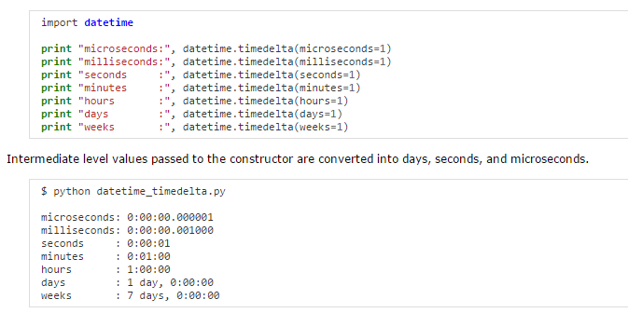
datetime – Timedelta
You can use datetime to perform basic arithmetic on date values via the timedelta class. Subtracting dates produces a timedelta, and a timedelta can be added or subtracted from a date to produce another date. The internal values for a timedelta are stored in days, seconds, and microseconds.

Slide 16
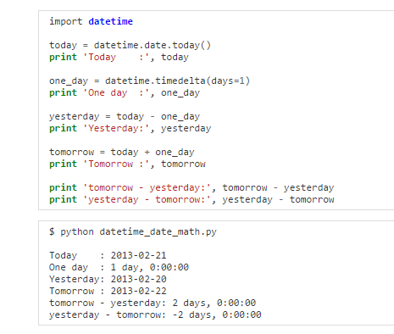
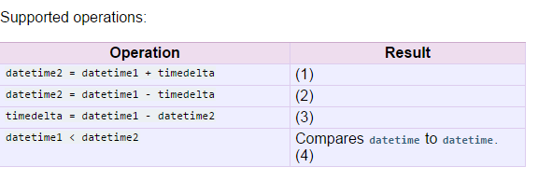
datetime – Arthmatic

